Slide 1

GET SIGN LANGUAGE & LIVE CAPTIONS EASILY
BENEFITS VHEAP ENJOYS
ADAM KARASCH
JOSEPH ALBERICI
  jalberici@karasch.com
  Tel. (800) 621-5689
  Karasch.com

Slide 2
WHAT YOU GET?
LIVE CAPTIONS
(CART)
AMERICAN SIGN LANGUAGE
(ASL)
99% Accurate real-time closed captions
Certified human captioners
Get service: Anywhere. Anytime.
Fast written scheduling confirmation
VHEAP References:
Radford University
University of Mary Washington
• Certified ASL interpreting professional
• Quick, easy ASL interpreter booking
• Remote / On-site / Hybrid
• 24/7 reliable coverage
• Personalized support

Slide 3
WHY YOU NEED IT?
ACCURACY
COMPLIANCE
PEACE OF MIND
Human = Accuracy
Consider:
multiple speakers
speaker identification
proper names
punctuation
foreign accents
mixed language
challenging audio
process prep material
Legal: ADA consequences
Ethical: Equal access
Cultural: foster empathy, connection, understanding
Commitment to inclusion and accessibility
Avoid misunderstandings
Cultural accuracy
Increased engagement
Better customer service
Improved morale
Positive public image

Slide 4
HOW WE’RE DIFFERENT?
ONE POINT OF CONTACT
ONE-STOP SHOP
CONVENIENT SECURE PORTAL
FREE TRANSCRIPT STORAGE
FREE WIRELESS MICS
WALK-THROUGHS, TESTING CONSULTATIONS INCLUDED
HUMAN:
NOT A.I.
WOMAN-OWNED
45 YEARS IN BUSINESS
FAMILY-OWNED & OPERATED
IMMEDIATE
RESPONSE
TIME

Slide 5
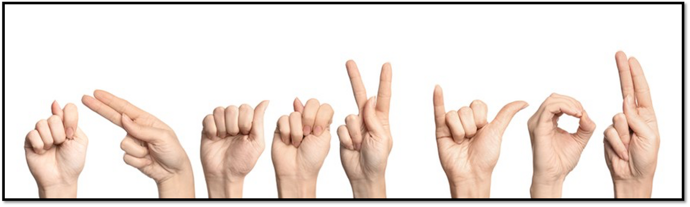
THANK YOU
Schedule Q&A
JAlberici@Karasch.com
Tel. (800) 621-5689

Slide 6


(TEXT)
(text)
(image)
(TEXT)
(text)
(text)
(TEXT)
(text)

Slide 7
(TEXT)
(text)
(TEXT)
(text)

